Slide 1
Automation with Cisco WebEx Teams
PARIDHI SRIVASTAVA
TECHNICAL CONSULTING ENGINEER - WIRELESS

Slide 2



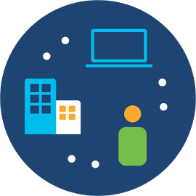



Webex Teams API
Webex Teams is a cloud based collaboration solution, which means Webex Teams APIs can be accessed publicly.
There are 2 ways to integrate products/services with Teams:
REST API
Webex Teams SDK
SDK
Products and Services

Slide 3
Webex Teams REST API
API Reference: https://developer.webex.com/docs/api/getting-started
Most of the APIs have common methods: GET,PUT,POST,DELETE.
Some of the most used APIs:
Memberships
Messages
People
Rooms
Webhooks

Slide 4
1
Memberships
2
Messages
WebEx Team APIs
3
People
4
Rooms
5
Webhooks

Slide 5
Webex Teams SDK
Documentation: https://github.com/CiscoDevNet/webexteamssdk
It is a community Developed Python Library (webexteamssdk)
Wraps all the API requests and returned JSON objects with Native Python Objects.

Slide 6
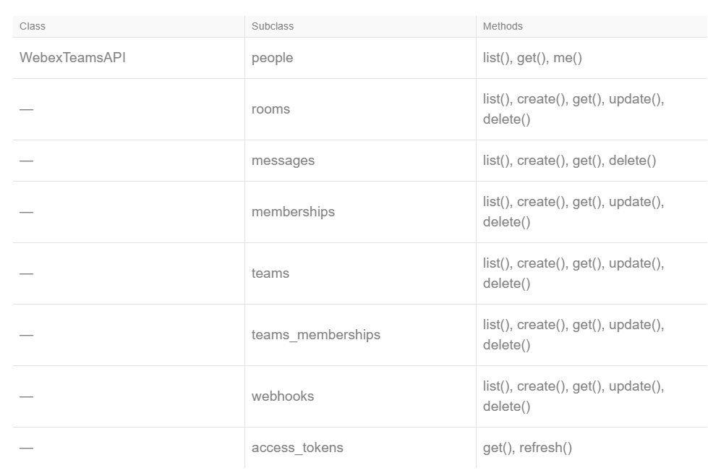
WebEx API Classes

Slide 7
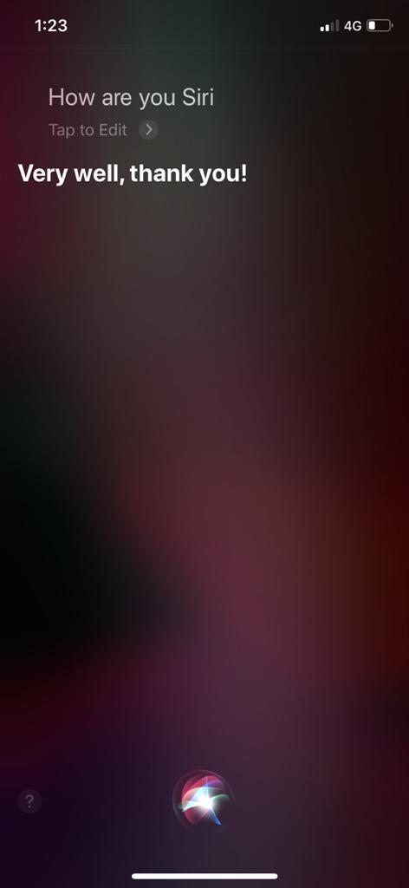
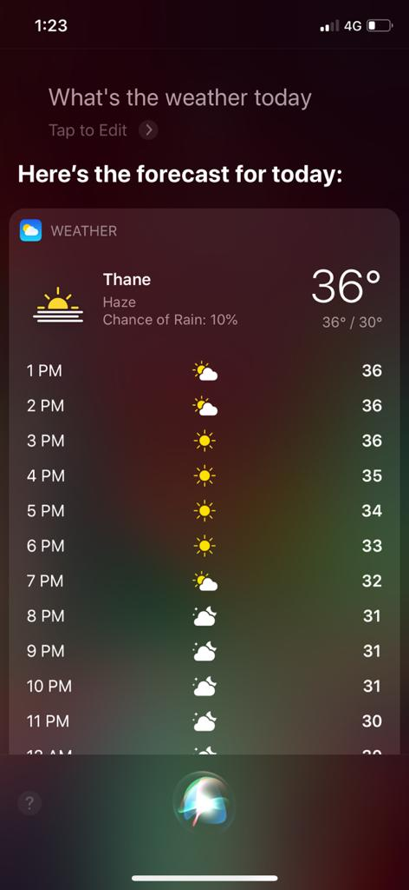
ChatBots

Slide 8
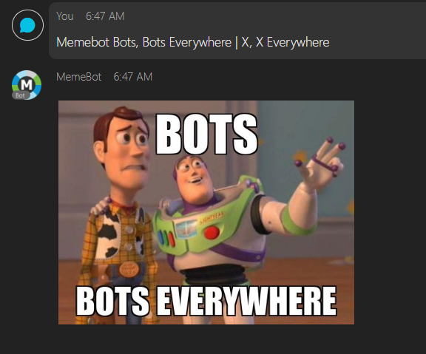
ChatBots
What is the need for ChatBots?
How to create a bot ?
Once you create the Bot, you will get the Access Token for the bot which never expires until refreshed.

Slide 9
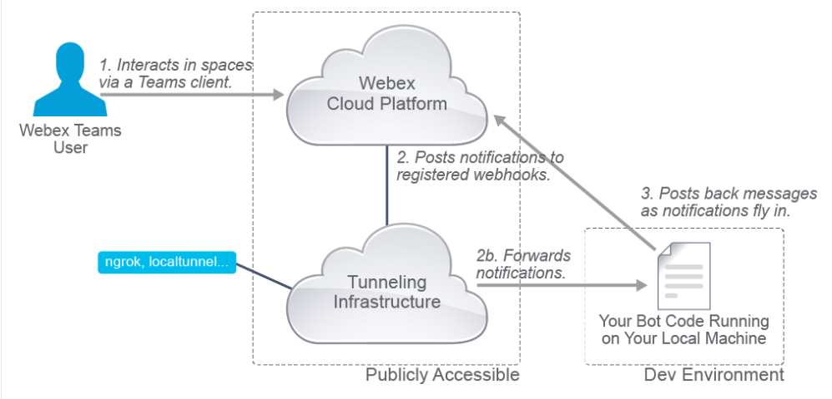
Webhooks
The client posts a message to the bot
The bot is subscribed to the webhook, so it will post the data to the publicly accessible URL
The application associated with the URL will interpret the messages and will respond back to Teams Cloud with the response.
Please note the URL should be accessible publicly, to simulate this in your lab, you can use ngrok.

Slide 10
Demo!

